Slide 1
Windows Utilities
Krisha Pahwa

Slide 2
What are Windows Utilities?
utility software specifically designed for Windows
utility software ⇒ software designed to support the machine's pre-existing infrastructure
differs from application software
"help analyze, configure, optimize or maintain a computer"
Notes:
https://en.wikipedia.org/wiki/Utility_software

Slide 3
Common Windows Utilities

Slide 4
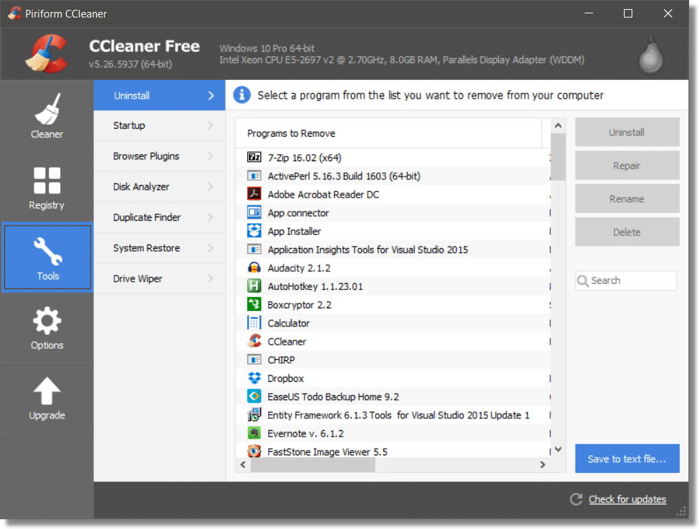
CCleaner
scans for unwanted/unneeded files
can scan and delete web browser data (history, cookies, download history, etc.)
remove during competitions
download link

Slide 5
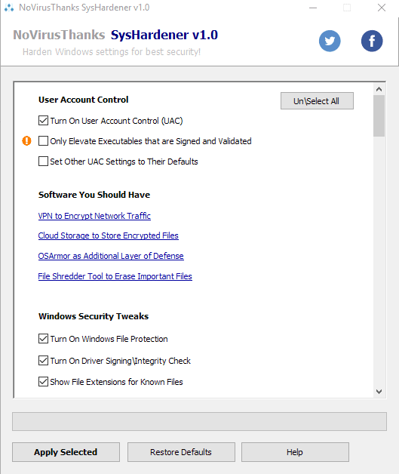
SysHardener
facilitates in hardening windows
unassociate "bad" file types (JS, VBS, VBE, etc.)
block outbound connection of commonly hijacked system programs
etc.
download link

Slide 6
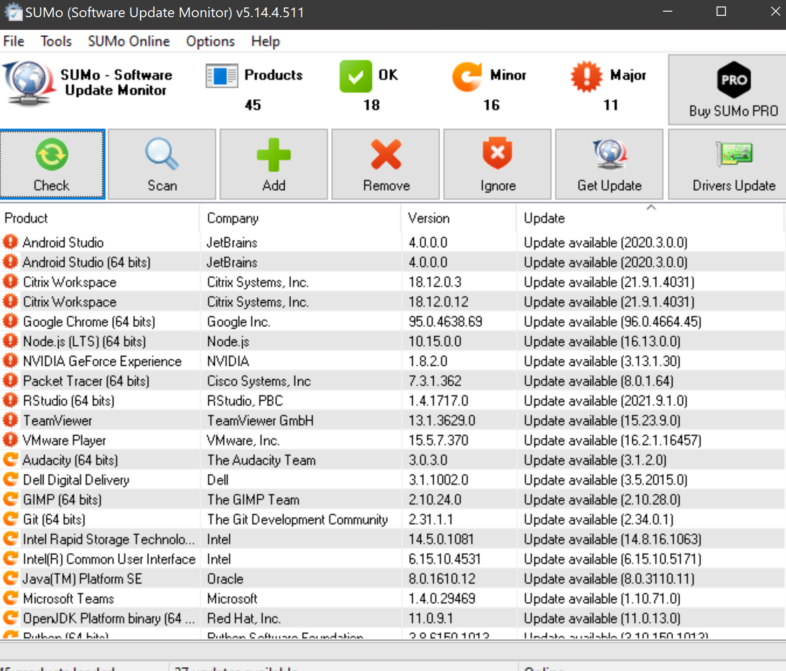
SUMo
helps keep track of updates
main benefit: alerts users of updates before the actual program is used
download link

Slide 7
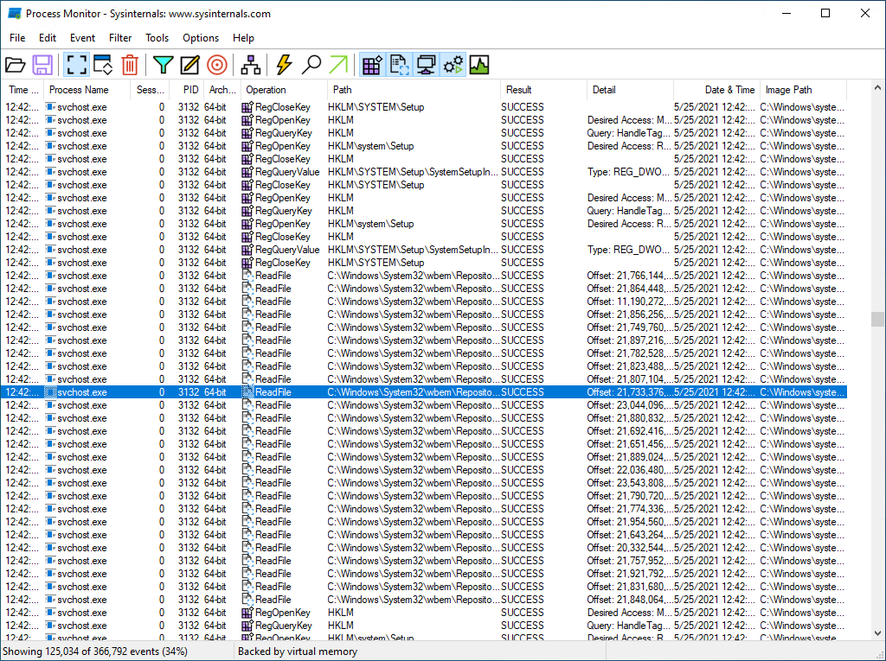
Sysinternals
family of products that includes:
process explorer ⇒ advanced version of windows task manager
Sysmon ⇒ collects and publishes system event for security analysis in the windows event log
download link

Slide 8
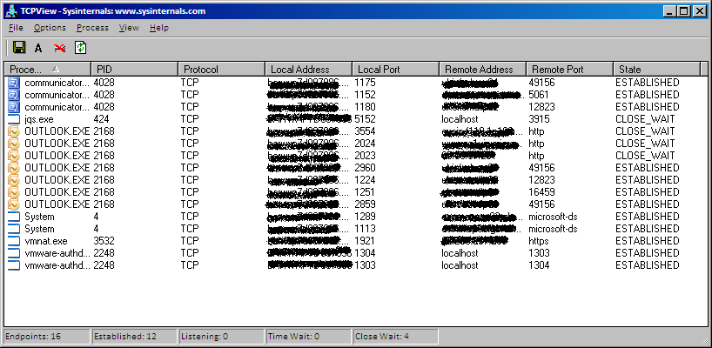
TCPView/TCPvcon
TCPView ⇒ GUI Interface version
TCPvcon ⇒ command line access
tcpvcon [-a] [-c] [-n] [process name or PID]
-a ⇒ show all endpoints
-c ⇒ print output as CSV
-n ⇒ don't resolve addresses
download link

Slide 9
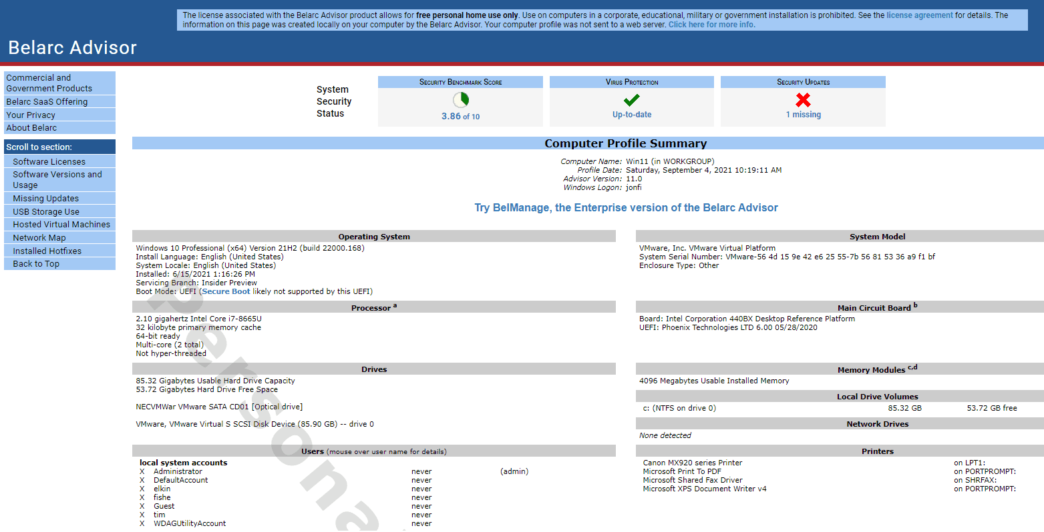
Belarc Advisor
compiles a detailed profile with information about:
installed programs
network inventory
missing security updates
anti-virus status
security benchmarks
download link

